Slide 1

CHAPTER 12 File Management
Instructor: Wuman LUO
luowuman@ipm.edu.mo
Office: A213
14:30-17:30 Tuesday & Wednesday

Slide 2
We’ll learn in this chapter...
File , and directory
File systems
Access control – Users or groups of users are granted certain access rights to a file
Simultaneous access – file locking
Secondary Storage Management, File system:
FAT, NTFS

Slide 3
Files
Data collections created by users
The File System is one of the most important parts of the OS to a user
Desirable properties of files:
Long-term existence
files are stored on disk or other secondary storage and do not disappear when a user logs off
Sharable between processes
files have names and can have associated access permissions that permit controlled sharing
Structure
files can be organized into hierarchical or more complex structure to reflect the relationships among files
3
Notes:
From the user’s point of view, one of the most important parts of an operating system is the file system. The file system provides the resource abstractions typically associated with secondary storage. The file system permits users to create data collections, called files, with desirable properties, such as:
• Long-term existence: Files are stored on disk or other secondary storage and do not disappear when a user logs off.
• Sharable between processes: Files have names and can have associated access permissions that permit controlled sharing.
• Structure: Depending on the file system, a file can have an internal structure that is convenient for particular applications. In addition, files can be organized
into hierarchical or more complex structure to reflect the relationships among files.

Slide 4
File Structure
Four terms are commonly used when discussing files:
Field
Record
File
Database
4
Notes:
Four terms are in common use when discussing files:
• Field
• Record
• File
• Database
A field is the basic element of data. An individual field contains a single value, such as an employee’s last name, a date, or the value of a sensor reading. It is characterized by its length and data type (e.g., ASCII string, decimal). Depending on the file design, fields may be fixed length or variable length. In the latter case, the field often consists of two or three subfields: the actual value to be stored, the name of the field, and, in some cases, the length of the field. In other cases of variable-length fields, the length of the field is indicated by the use of special demarcation symbols between fields.
A record is a collection of related fields that can be treated as a unit by some application program. For example, an employee record would contain such fields as name, social security number, job classification, date of hire, and so on. Again, depending on design, records may be of fixed length or variable length. A record will be of variable length if some of its fields are of variable length or if the number of fields may vary. In the latter case, each field is usually accompanied by a field name. In either case, the entire record usually includes a length field.
A file is a collection of similar records. The file is treated as a single entity by users and applications and may be referenced by name. Files have file names and
may be created and deleted. Access control restrictions usually apply at the file level. That is, in a shared system, users and programs are granted or denied access to entire files. In some more sophisticated systems, such controls are enforced at the record or even the field level.
Some file systems are structured only in terms of fields, not records. In that case, a file is a collection of fields.
A database is a collection of related data. The essential aspects of a database are that the relationships that exist among elements of data are explicit and that the database is designed for use by a number of different applications. A database may contain all of the information related to an organization or project, such as a business or a scientific study. The database itself consists of one or more types of files. Usually, there is a separate database management system that is independent of the operating system, although that system may make use of some file management programs.

Slide 5
File Directories
Contains information about files
attributes: read only, creation date, size, etc..
location: where the file resides on hard disk
ownership
Directory itself is a file

Slide 6
Access Rights
None
user may not know the existence of the file
Knowledge
user can only determine that the file exists and who its owner is
Execution
can load and execute a program but cannot copy it

Slide 7
Access Rights
Reading
can read the file (incl. copying and execution)
Appending
can only add data to the file
Updating
can modify, delete, and add data
Changing protection
can change access rights granted to other users

Slide 8
Access Rights
Deletion
can delete the file
Owners
has all rights previously listed
may grant rights to others

Slide 9
9
Notes:
One user is designated as owner of a given file, usually the person who initially created a file. The owner has all of the access rights listed previously and may grant rights to others. Access can be provided to different classes of users:
• Specific user: Individual users who are designated by user ID
• User groups: A set of users who are not individually defined. The system must
have some way of keeping track of the membership of user groups.
• All: All users who have access to this system. These are public files.

Slide 10
Simultaneous Access
Readers/Writers problem
User may lock entire file before updating
User may lock the individual records during the update

Slide 11
Secondary Storage Management
Space on disks is allocated to each file
File system must keep track of which parts are allocated to which file, and also the available space
Space is allocated as one or more contiguous units or portions

Slide 12
Cluster
For the OS, the hard disk storage space is divided in equal size chunks called cluster
0
1
2
3
4
5
6
7
8
9
10
11
12
13
14
15
16
17
18
19
20
..
..
..
..
12

Slide 13
File Allocation
Each file occupies a number of clusters, not necessarily contiguous
The file system has to keep track of which clusters are allocated to a file, and which are free
A1
A2
A3
A4
C3
C4
B1
B2
C1
C2
13

Slide 14
The FAT File System
Uses a File Allocation Table (FAT) to store the linked list of clusters used by a file
A1
A2
A3
A4
C3
C4
B1
B2
C1
C2
FAT
3
4
5
nil
9
nil
Directory \tmp: File A, 15k, starts at cluster 2 File B, 8k, starts at cluster 12 File C, 13k, starts at cluster 16
13
nil
17
8
14
Notes:
The number in the FAT table is the pointer to the next cluster. Use the directory to find the starting cluster.

Slide 15
FAT16, FAT32
FAT16, 16 bit is used to address cluster. Max number of cluster = 2^16.
FAT32: 32 bit is used to address cluster. Max number of cluster = 2^32.
For a comparison: http://www.ntfs.com/ntfs_vs_fat.htm
15

Slide 16
Size of FAT
For small disk, e.g. floppy, the FAT is small and so can be kept in memory.
1.44M floppy FAT 16, 512 bytes cluster
Number of cluster = 1.44M / 512 = 2847
Size of FAT = 16 bit * 2847 = 5694 byte
In a large FAT partition, the File Allocation Table is too large to be cached in memory all the time. File operation on large, highly fragmented file will be slow.
8G FAT 32 partition using 4k cluster
Number of cluster = 8G / 4k = 2 M = 2 * 2^20
Size of FAT = 32 bit * 2 M = 8 MB
16

Slide 17
FAT File System on Disk
3
4
5
FAT
nil
9
nil
13
nil
17
8
nil
A1
A2
A3
A4
C3
C4
Directory \tmp: File A, 15k, starts at cluster 2 File B, 8k, starts at cluster 12 File C, 13k, starts at cluster 16
B1
B2
C1
C2
\tmp
17

Slide 18
Windows File System
Key features of New Technology File System (NTFS)
Recoverability
Security
Large disks and large files
Multiple data streams
Journaling
Compression and Encryption
18
Notes:
Brief Overview of Windows File System
NTFS (New Technology File System) Overview
NTFS is currently the primary file system used by Windows XP. It was first introduced with Windows NT.
The Microsoft Windows XP Professional Resource Kit Documentation [Microsoft 04] is a comprehensive NTFS resource. The following excerpts are from the site.
NTFS replaces the FAT and uses a master file table (MFT), which is the first file on the disk. Records within the MFT are called meta-data and this contains information on all files located on the disk, including system files. A key advancement is the way files and directories are both stored on the disk with attributes that include security information. At format the MFT assigns logical cluster numbers (LCN) to the disk’s entire partition. These LCNs allow the OS to read and write data on the disk. Each LCN is similarly linked to a virtual cluster number (VCN) which allows files to extend beyond across the free disk space area of the hard drive.
NTFS File System Features
File and Folder Permissions
On NTFS volumes you can set permissions on files and folders that specify which groups and users have access, and what level of access is permitted. NTFS file and folder permissions apply to users on the local computer and to users accessing the file or folder over the network. File and folder permissions are maintained in discretionary access control lists.
Encryption
The encrypting file system (EFS) uses symmetric key encryption in conjunction with public key technology to protect files and folders. Encryption ensures that only the authorized users and designated recovery agents of that file or folder can access it. Users of EFS are issued a digital certificate with a public key and a private key pair. EFS uses the key set for the user who is logged on to the local computer where the private key is stored.
Users work with encrypted files and folders just as they do with any other files and folders. Encryption is transparent to any authorized users; the system decrypts the file or folder when the user opens it. When the file is saved, encryption is reapplied. However, intruders who try to access the encrypted files or folders receive an "Access denied" message if they try to open, copy, move, or rename the encrypted file or folder.
Larger Volume Size
The maximum NTFS volume size as implemented in Windows XP Professional is 232 clusters minus 1 cluster, which is approximately 256 terabytes with a max individual file size of about 16 terabytes. Under FAT32, the maximum volume size was 32Gig with a 4 Gig file. This has considerable impact on storage requirement for making forensic duplications and putting together fragmented files.
Multiple Data Streams
A data stream is a sequence of bytes. An application populates the stream by writing data at specific offsets within the stream. The application can then read the data by reading the same offsets in the read path. Every file has a main, unnamed stream associated with it, regardless of the file system used. However, NTFS supports additional named data streams in which each data stream is an alternate sequence of bytes as illustrated in the figure. Applications can create additional named streams and access the streams by referring to their names. This feature permits related data to be managed as a single unit. For example, a graphics program can store a thumbnail image of bitmap in a named data stream within the NTFS file containing the image.
A forensic examiner is particularly interested in these multiple data streams since they can hide data either intentionally or by coincidence. The data stream is an additional data attribute of a file.
Cluster Size
As described previously, the cluster size has also significantly increased with NTFS.
NTFS Recoverability
NTFS is a recoverable file system that guarantees the consistency of the volume by using standard transaction logging and recovery techniques. In the event of a disk failure, NTFS restores consistency by running a recovery procedure that accesses information stored in a log file. The NTFS recovery procedure is exact, guaranteeing that the volume is restored to a consistent state. Transaction logging requires a very small amount of overhead.
NTFS ensures the integrity of all NTFS volumes by automatically performing disk recovery operations the first time a program accesses an NTFS volume after the computer is restarted following a failure.
NTFS also uses a technique called cluster remapping to minimize the effects of a bad sector on an NTFS volume. For more information, see "Cluster Remapping" later in this chapter.
A reparse point is a collection of user-defined data you assign to a file or a folder. The format of this data is understood by the application, which stores the data, and a file system filter, which you install to interpret and process it for that file or folder.

Slide 19
NTFS Volume and File Structure
Sector
The smallest physical storage unit on the disk
Almost always 512 bytes
Cluster
One or more contiguous sectors
Size in sectors is a power of 2
Volume
Logical partition on a disk, consisting one or more clusters and used by a file system to allocate space
19
Notes:
Sector: The smallest physical storage unit on the disk.
almost always 512 bytes.
Cluster: One or more contiguous (next to each other on the same track) sectors. The maximum file size supported by NTFS is 2^32 clusters, which is equivalent to a maximum of 2^48 bytes. A cluster can have at most 2^16 bytes.
Volume: A logical partition on a disk, consisting of one or more clusters and used by a file system to allocate space.
At any time, a volume consists of a file system information, a collection of files, and any additional unallocated space remaining on the volume that can be allocated to files.
A volume can be all or a portion of a single disk or it can extend across multiple disks.
If hardware or software RAID 5 is employed, a volume consists of stripes spanning multiple disks.
The maximum volume size for NTFS is 2⁶⁴ bytes.

Slide 20
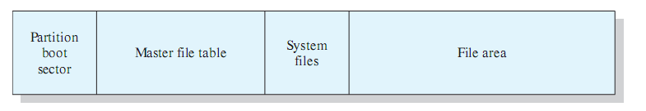
NTFS Volume Layout
Every element on a volume is a file, and every file consists of a collection of attributes.
Even the data contents of a file is treated as an attribute.
20
Notes:
The first few sectors on any volume are occupied by the partition boot sector which contains information about the volume layout and the file system structures as well as boot startup information and code.
master file table (MFT) contains information about all of the files and folders (directories) on this NTFS volume.
The MFT is a list of all files and their attributes on this NTFS volume, organized as a set of rows in a relational database structure.
system files. typically about 1 Mbyte in length includes:
MFT2: A mirror of the first three rows of the MFT, used to guarantee access to the MFT in the case of a single-sector failure
Log file: A list of transaction steps used for NTFS recoverability
Cluster bit map: A representation of the volume, showing which clusters are in use
Attribute definition table: Defines the attribute types supported on this volume and indicates whether they can be indexed and whether they can be recovered during a system recovery operation

Slide 21
Master File Table (MFT)
In NTFS, (almost) all metadata about the files are stored in a system file name $MFT. Each row of MFT is 1024 bytes long and stores the name(s), standard file attributes like read-only, time stamps, security descriptor, and data for a file. If the file is very small, the content is stored in the file record inside MFT.
Standard information
File name
Security descriptor
Data
21

Slide 22
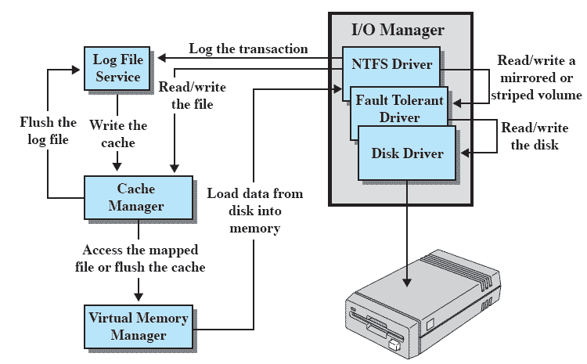
Windows NTFS Components
22
Notes:
I/O manager: Includes the NTFS driver, which handles the basic open, close, read, write functions of NTFS.
Log file service: Maintains a log of file system metadata changes on disk.
The log file is used to recover an NTFS-formatted volume in the case of a system failure (i.e., without having to run the file system check utility).
Cache manager: Responsible for caching file reads and writes to enhance performance.
The cache manager optimizes disk I/O.
Virtual memory manager: The NTFS accesses cached files by mapping file references to virtual memory references and reading and writing virtual memory.

Slide 23
Next Topic
Preparation for Final Examination
Chapter 1,2,3,4,5*,7*,8*,11*,12*.

